Slide 1
Informality and Development
La Porta and Shleifer

Slide 2
Five Facts About the Informal Economy
The informal economy is huge
It has extremely low productivity compared to the formal economy
Regulation is not what keeps informal firms down
Informal firms rarely become formal
As countries develop, informality becomes less important

Slide 3
1. Huge Informal Economy
Much of informality is in farming in both subsistence agriculture and informal sales of marketable crops
Most forms of employment come from self-employed sellers/peddlers living at/near subsistence levels

Slide 4
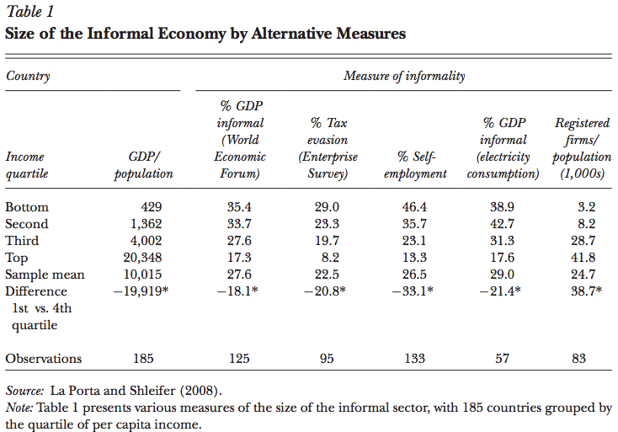
1. Huge Informal Economy
Even more established firms like repair shops, furniture and metal factories have apparent informalities
Don’t register and regulations are ignored
Make sales/pay for inputs including labor in cash
Don’t have bank accounts
Don’t pay taxes
Some registered firms hide some of their sales from authorities to reduce profit taxes

Slide 5
2. Informal Firms are Small, Unproductive and Stagnant
Informal firms are much smaller than formal firms
Average formal firm employs 126 people vs informal firm employs 4
Informal firms are much less productive
Productivity calculated as value added per employee (sales net of expenditures on raw materials and energy)
Huge difference between informal firms and formal firms of the same size
Averaging across countries, wages in informal firms are ½ of those in small formal firms and less than 1/3 of those in large formal firms
Low added value per employee in informal sector reflects the extremely low quality of products by informal firms

Slide 6
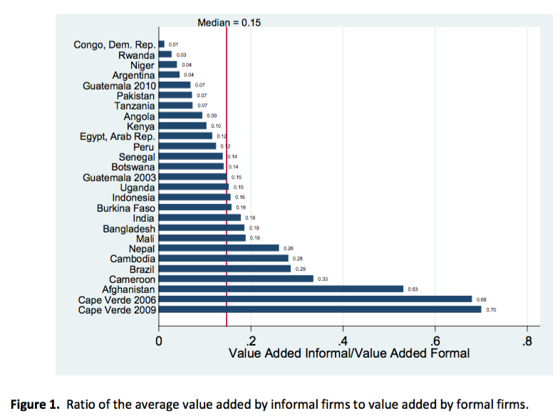

Slide 7
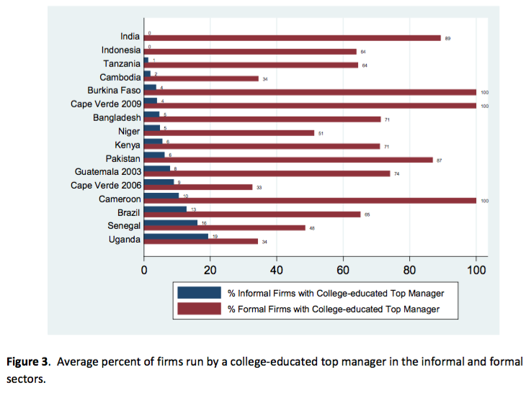
2. Informal Firms are Small, Unproductive and Stagnant
Differences in the human capital (education) of workers are small
However, big difference in human capital of managers

Slide 8
3. Regulation is Not What Keeps Informal Firms Down
Although informal firms avoid taxes and registration costs, government regulations are distant concerns
Fewer than 10% of either informal or formal firms worry about corruption, business licensing and permits, or the legal system
Lack of land is a bigger issue for informal firms because most occupy their premises illegally and fear eviction
Informal firms face problems of corruption, police abuse, and crime
Don’t believe that formality will address these issues and firms will face these issues anyhow

Slide 9
4. Informal Firms Rarely Become Formal
On average, 91% of registered firms started out as registered
An averaged surveyed informal firm has been in business for around a decade with no attempt to become formal
Informal firms inhabit an economic space of their own, disconnected from the formal space

Slide 10
4. Informal Firms Rarely Become Formal
Which government actions induce informal firms to register?
Experiment in Brazil: the likelihood of registering increases by 21% to 27% if the firm receives an actual inspection
Most informal firms do not become formal unless forced to do so
Experiment in Sri Lanka: information about the registration process and even actual reimbursement of direct costs of registration had no effect on formality
Informal firms start out and live out informally, avoid taxes and regulations, don’t trade with the formal sector
Difficult to lure them into becoming formal, even with subsidies.

Slide 11
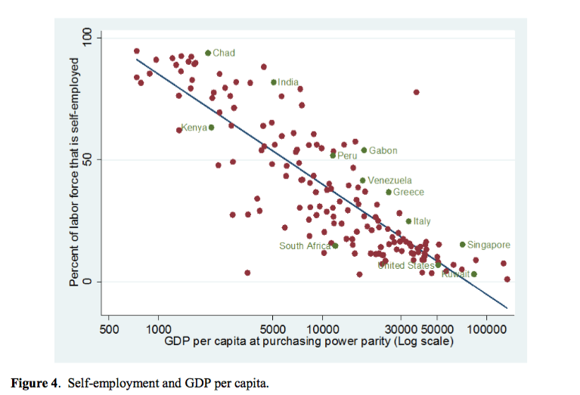
5. As Countries Develop, Informality Becomes Less Important
The size of the informal economy declines with per capita income
As an economy develops, informality shrinks

Slide 12
Dual View of Informality
Why don’t we see more informal entrepreneurs restarting their businesses formally?
Why don’t informal furniture producers buy capital and start modern factories?
Why don’t street peddlers open modern stores?
Why don’t formal firms capture the whole market straight away and drive out the informal firms if formal firms are so efficient?

Slide 13
Dual View of Informality
Formal firms have to pay taxes and comply with regulations
Huge cost disadvantage relative to informal firms
Joining the formal sector would raise costs of informal firms significantly
Taxes and regulations are only part of the story that divides the two sectors
Lewis’s dual view of informality: sees formal and informal economies as largely segregated, producing different products with different labor, capital and entrepreneurial inputs, and serving different customers
Other economic forces (demand and supply side) keep two sectors separate

Slide 14
Economic Forces of Dualism
Entrepreneurs need to generate sufficient sales to cover fixed investment costs
When economy is poor, demand for modern products may not suffice to cover fixed costs
Extreme case where there’s significant poverty and almost no modern goods are bought
Informal sector produces low quality goods to people, who are also informal workers and who can’t afford higher quality and more expensive products from the formal sector
Formal sector remains small and produces high quality goods for a small portion of formal workers
Big Push Theory: simultaneous modernization of multiple sectors of the economy generates sufficient demand for the products of modern sector from its own employees to actually make the transition to formality profitable
Formal workers making quality shoes in formal leather factories buy quality chairs made by formal workers employed by formal furniture makers, and vice versa

Slide 15
Economic Forces of Dualism
Population growth may slow down decline of informal sector
Formal sector is capital intensive; informal sector is labor intensive
Keep demand for informal goods and supply of informal workers high
If labor flows toward formal sector, population growth would not flow fast enough to kill informality
Managerial inputs are important for productivity
Informal managers are considerably less educated than formal managers
Informal managers can’t just start larger formal firms and operate them well enough to survive in the formal sector because they simply don’t know how to
Government may play a role in separating formal and informal economies
Tax avoidance by informal firms undermines government tax collection (and therefore the provision of public goods) which makes joining the formal sector to access public goods less attractive

Slide 16
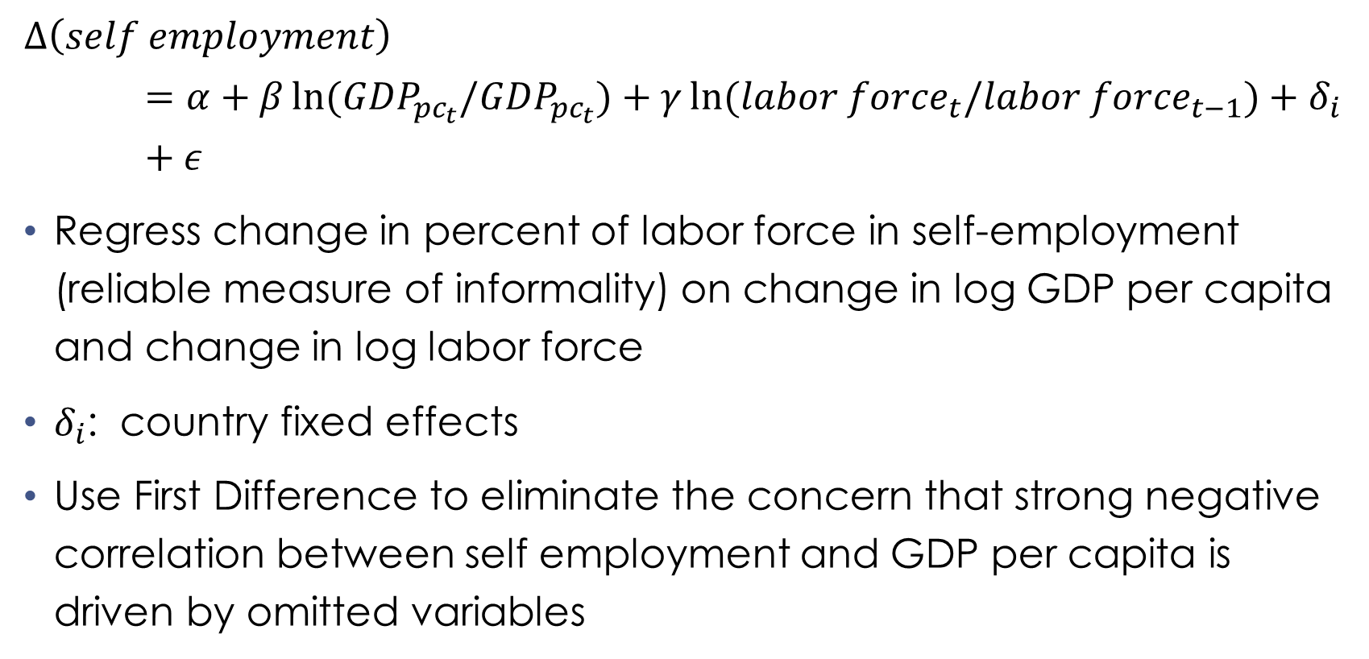
The Model
$$∆\left(self employment\right)=α+β\ln{{(GDP}_{{pc}_{t}}/{GDP}_{{pc}_{t}})}+γ\ln{{(labor force}_{t}/{labor force}_{t−1})}+δ_{i}+ε$$
Regress change in percent of labor force in self-employment (reliable measure of informality) on change in log GDP per capita and change in log labor force
$δ_{i}$: country fixed effects
Use First Difference to eliminate the concern that strong negative correlation between self employment and GDP per capita is driven by omitted variables

Slide 17
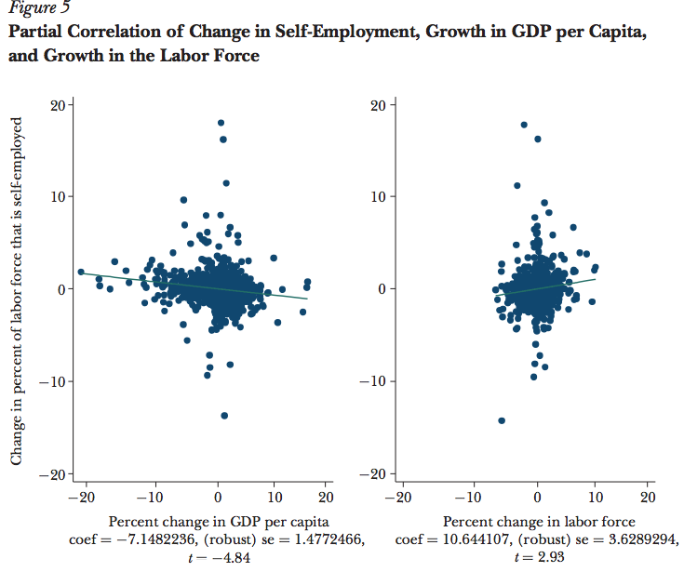
Left panel: faster economic growth is associated with a more rapid decline in self-employment
Right Panel: faster labor force growth is associated with a slower decline in self-employment
Transition to formality is driven by economic growth, but it is very slow, and even slower when labor force growth is fast

Slide 18
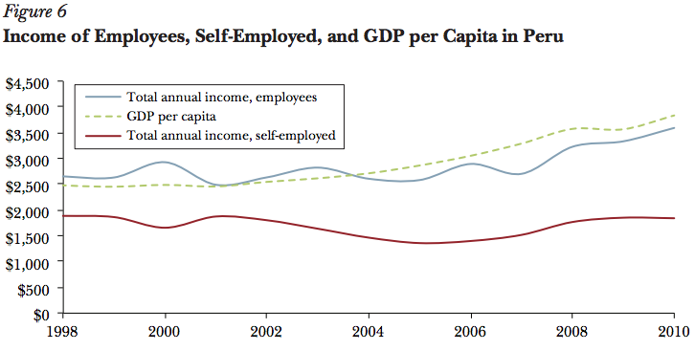
Peru
1990-2012: Peruvian economy has grown (2.1 fold)
Labor force grew almost as fast as its per capita income and labor absorption was done by the informal sector
Despite economic growth, share of formal employment decreased, share of informal employment increased (even though level of total formal employment rose from 5 million to 8 million)
Incomes of the self-employed did not rise and growth was driven by the formal sector and the informal sector stagnated

Slide 19
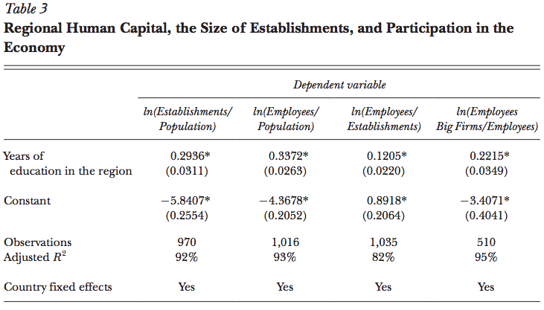
Supply Side
The more educated regions have more formal establishments per capita, more formal employees both relative to population and relative to the number of establishments, and more formal employees employed in large firms relative to population
Transition to a formal economy appears to be driven by human capital

Slide 20
Conclusion
Evidence of dual view of informality
Informal firms stay informal: they hire informal workers, buy their inputs, and sell their products all for cash, they are unproductive and are unlikely to benefit from becoming formal
Informality declines slowly with development
Policy implications: informal firms are extremely inefficient so there needs to be extreme caution with policies that impose on them any kind of additional costs
Growth that kills the informal sector is driven by the formation and expansion of formal firms managed by educated entrepreneurs
Policy message for how to grow the formal economy and shrink the informal one is to increase, whether through immigration or education and training, the supply of educated entrepreneurs

Slide 21
Comments
Value Added
La Porta and Shleifer connects value added and quality of goods made by informal firms
Value added per employee reflects low quality of products in informal sector
Quality is hard to measure: they use anecdotal evidence to describe ‘quality’ of products
Productivity is calculated as value added per employee (sales net of expenditures on raw materials and energy)
Productivity measured by output per worker instead of revenue per worker?

